Slide 1
Software Engineering Week 7,8
Instructor : Dr. Natash Ali Mian
School of Computer and Information Technology
Beaconhouse National University

Slide 2
What is UML and Why we use UML?
Why we use UML?
Use graphical notation: more clearly than natural language (imprecise) and code (too detailed).
Help acquire an overall view of a system.
UML is not dependent on any one language or technology.
UML moves us from fragmentation to standardization.

Slide 3
Use Case
Use Case
(Representation of a Single requirement in a diagram form)
Use Case Diagram
Collection of a few requirements/ collection of a few use cases
Use Case Model
A complete representation of all users/actors and their requirements

Slide 4
Actors (User of the system)
Link (line)
Use Case (Feature)
System Boundary

Slide 5
1
View Attendance
View Fee
View Result
View Academic History
View Enrolment
Print
View Attendance and then print it
View Academic History and print it

Slide 6
2
View my fee
View my fee and Print
View Attendance
View Attendance and Print
View Attendance &
Print Attendance
View Result and Print
View Academic History and Print
View Enrolment and Print

Slide 7
View Attendance
Print
View Fee
View Grades

Slide 8
3
View Attendance
Print Attendance
View Result
Print Result
View Academic History
Print Academic History
View Enrolment
Print Enrolment

Slide 9
Use-Case Diagrams
A use-case diagram is a set of use cases
A use case is a model of the interaction between
External users of a software product (actors) and
The software product itself
More precisely, an actor is a user playing a specific role
describing a set of user scenarios
capturing user requirements
contract between end user and software developers

Slide 10
Use-Case Diagrams
Use Case
Boundary
Actor
Library System
Borrow
Employee
Client
Order Title
Fine Remittance
Supervisor

Slide 11
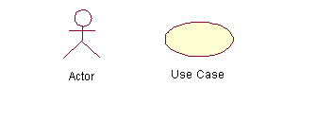
Use-Case Diagrams
Actors: A role that a user plays with respect to the system, including human users and other systems. e.g., inanimate physical objects (e.g. robot); an external system that needs some information from the current system.
Use case: A set of scenarios that describing an interaction between a user and a system, including alternatives.
System boundary: rectangle diagram representing the boundary between the actors and the system.

Slide 12
Use-Case Diagrams
Association:
communication between an actor and a use case; Represented by a solid line.
Generalization: relationship between one general use case and a special use case (used for defining special alternatives) Represented by a line with a triangular arrow head toward the parent use case.

Slide 13
Use-Case Diagrams
Include: a dotted line labeled <<include>> beginning at base use case and ending with an arrows pointing to the include use case. The include relationship occurs when a chunk of behavior is similar across more than one use case. Use “include” in stead of copying the description of that behavior.
<<include>>
Extend: a dotted line labeled <<extend>> with an arrow toward the base case. The extending use case may add behavior to the base use case. The base class declares “extension points”.
<<extend>>

Slide 14
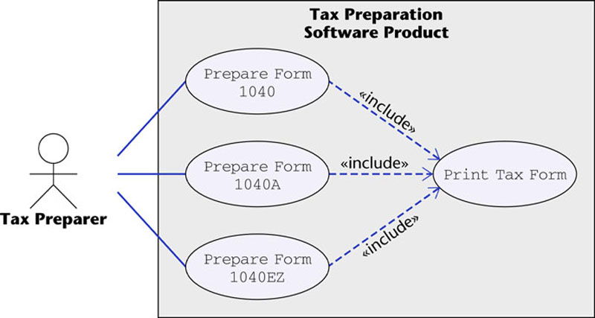
Use-Case Diagrams
Figure 16.12
The McGraw-Hill Companies, 2005

Slide 15
Interaction Diagrams
show how objects interact with one another
UML supports two types of interaction diagrams
Sequence diagrams
Collaboration diagrams

Slide 16
Sequence Diagram(make a phone call)
Caller
Phone
Recipient
Picks up
Dial tone
Dial
Ring notification
Ring
Picks up
Hello

Slide 17
Sequence Diagram:Object interaction
A
B
Self-Call: A message that an
Object sends to itself.
Condition: indicates when a message is sent. The message is sent only if the condition is true.
Synchronous
Asynchronous
Transmission delayed
Condition
[condition] remove()
Iteration
*[for each] remove()
Self-Call

Slide 18
Void main ()
{
Int x;
if (expression)
{
int a ;
}
}
variable can be used/ accessed - SCOPE
Existence of variable in the memory – LIFETIME

Slide 19
Sequence Diagrams – Object Life Spans
Creation
Create message
Object life starts at that point
Activation
Symbolized by rectangular stripes
Place on the lifeline where object is activated.
Rectangle also denotes when object is deactivated.
Deletion
Placing an ‘X’ on lifeline
Object’s life ends at that point
A
Create
B
Activation bar
X
Return
Deletion
Lifeline

Slide 20
Sequence Diagram
Message
Sequence diagrams demonstrate the behavior of objects in a use case by describing the objects and the messages they pass.
The horizontal dimension shows the objects participating in the interaction.
The vertical arrangement of messages indicates their order.
The labels may contain the seq. # to indicate concurrency.

Slide 21
Class Diagram
Object Oriented Design
Set of Classes (interacting components)
Modules, Components, Classes

Slide 22
Class Name
Possible Attributes
Possible Operations/functions
Relationship with : A ()
Relationship with : B ()
Real life objects
Generalized Class

Slide 23
Access Specifier Private Protected Class A Class B is a child of class A (It will inherit/access all functions of class A that are either public or protected) Public private: Int a; int b int c public:
Class Name
Set of Variables
Set of Function
Class SE_Test
PR int a; PR PT
PU int sum (int a, int b);

Slide 24
Cardinality
1 – 1
1 – N
M – N
One Teacher teaches how many students? MANY
One student is taught by how many teachers? MANY
Student
Teacher

Slide 25
1
1
b
a
c
x
d

Slide 26
b
a
c
a
a
d

Slide 27
Class – Structure Abstract Data Type / User Defined Type
MasterClass
Var_1 (data type, access specifier) Var 2 (data type, access specifier) Var 3 (data type, access specifier) Var 4 (data type, access specifier)
Func 1 () Func 2 () Func 3 () Func 4 ()
ClassB
int Var5 float Var6 MASTERCLASS var7
Func a () Func b ()
ClassB sends the call (function call) to Masterclaass with parameters (function parameters). The instruction (function call) is to add two numbers. INST1 (a,b), result will be the sum of a and b.
INT
MASTERCLASS
CLASSB
int a,b,c,d;
MASTERCLASS b;
Primitive Data Type

Slide 28
Class defines the type of variables and the functions that can be performed. Physical Instance of the class - > (Object) Object is the physical instance of the class.
b
Var 1 =0 Var 2 =0 Var 3 =0 Var 4 =0
Func 1 () Func 2 () Func 3 () Func 4 ()
Var7
Var 1 =0 Var 2 =0 Var 3 =0 Var 4 =0
Func 1 () Func 2 () Func 3 () Func 4 ()
Obj
Var5= 10 Var6 =0 var7
Func a () Func b ()
MASTERCLASS b,var7;
Var7.func1(1,3);
Obj.func4(1,2,2,4,4,4);
Obj.var1= 35;

Slide 29
Class diagram
A class diagram depicts classes and their interrelationships
Used for describing structure and behavior in the use cases
Provide a conceptual model of the system in terms of entities and their relationships
Used for requirement capture, end-user interaction
Detailed class diagrams are used for developers

Slide 30
Class diagram
Each class is represented by a rectangle subdivided into three compartments
Name
Attributes
Operations
Modifiers are used to indicate visibility of attributes and operations.
‘+’ is used to denote Public visibility (everyone)
‘#’ is used to denote Protected visibility (friends and derived)
‘-’ is used to denote Private visibility (no one)
By default, attributes are hidden and operations are visible.

Slide 31
Class diagram
Name
Account_Name
- Customer_Name
- Balance
Attributes
+addFunds( )
+withDraw( )
+transfer( )
Operations

Slide 32
OO Relationships
There are two kinds of Relationships
Generalization (parent-child relationship)
Association (student enrolls in course)
Associations can be further classified as
Aggregation
Composition

Slide 33
OO Relationships: Generalization
Supertype
Example:
Customer
Regular
Customer
Loyalty
Customer
Subtype1
Subtype2
-Inheritance is a required feature of object orientation
-Generalization expresses a parent/child relationship among related classes.
Used for abstracting details in several layers

Slide 34
OO Relationships: Association
Represent relationship between instances of classes
Student enrolls in a course
Courses have students
Courses have exams
Etc.
Association has two ends
Role names (e.g. enrolls)
Multiplicity (e.g. One course can have many students)
Navigability (unidirectional, bidirectional)

Slide 35
Association: Multiplicity and Roles
student
1
*
University
Person
0..1
*
employer
teacher
Multiplicity
Symbol Meaning
1 One and only one
0..1 Zero or one
M..N From M to N (natural language)
* From zero to any positive integer
0..* From zero to any positive integer
1..* From one to any positive integer
Role
Role
“A given university groups many people; some act as students, others as teachers. A given student belongs to a single university; a given teacher may or may not be working for the university at a particular time.”

Slide 36
1 – M 1 - * ( Zero to Many)
1 – 5 (One to many), min one and maximum five
10 – 50 ( Many to Many), minimum ten and maximum 50

Slide 37
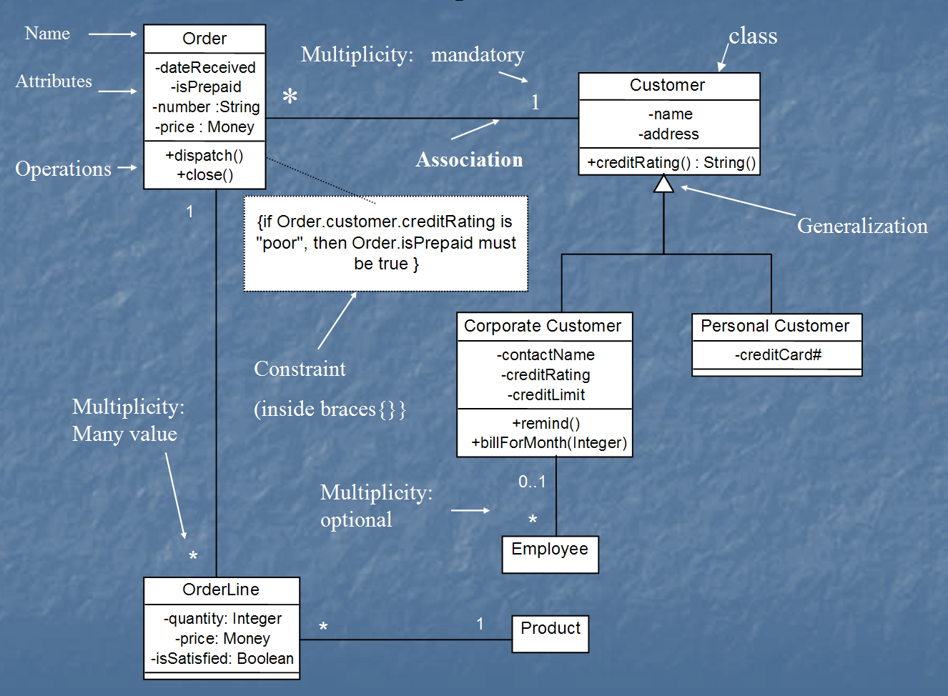
Class diagram
[from UML Distilled Third Edition]

Slide 38
Association: Model to Implementation
*
4
Student
Course
has
enrolls
Class Student {
Course enrolls[4];
}
Class Course {
Student have[];
}

Slide 39
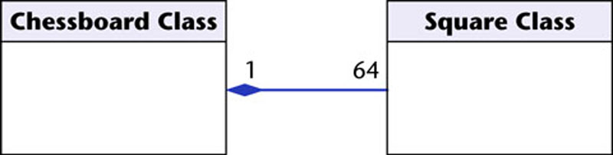
OO Relationships: Composition
Class W
Association
Models the part–whole relationship
Composition
Also models the part–whole relationship but, in addition, Every part may belong to only one whole, and If the whole is deleted, so are the parts
Example:
A number of different chess boards: Each square belongs to only one board. If a chess board is thrown away, all 64 squares on that board go as well.
Whole Class
Class P₁
Class P₂
Part Classes
[From Dr.David A. Workman]
Example
Figure 16.7
The McGraw-Hill Companies, 2005

Slide 40
OO Relationships: Aggregation
Container Class
Aggregation:
expresses a relationship among instances of related classes. It is a specific kind of Container-Containee relationship.
express a more informal relationship than composition expresses.
Aggregation is appropriate when Container and Containees have no special access privileges to each other.
Class C
AGGREGATION
Class E₁
Class E₂
Containee Classes
Example
Bag
Apples
Milk
[From Dr.David A. Workman]

Slide 41
Aggregation vs. Composition
Composition is really a strong form of association
components have only one owner
components cannot exist independent of their owner
components live or die with their owner
e.g. Each car has an engine that can not be shared with other cars.
Aggregations
may form "part of" the association, but may not be essential to it. They may also exist independent of the aggregate. e.g. Apples may exist independent of the bag.

